Slide 1
I Beat the Odds
Book by: Michael Oher
Report by: Whitney Waddell

Slide 2
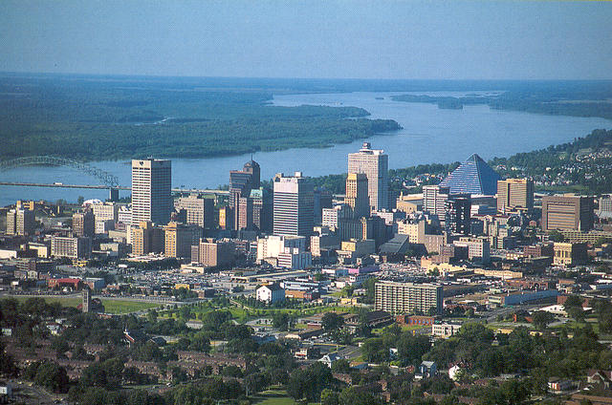
Settings
This story took place in Memphis, Tennessee and Oxford, Mississippi. Memphis is where most of his childhood and teenage years took place. In his childhood, he lived in a place called “Hurt Village” before he went through Child Protective Services and foster care. Oxford, Mississippi is where he went to college and played college football.

Slide 3
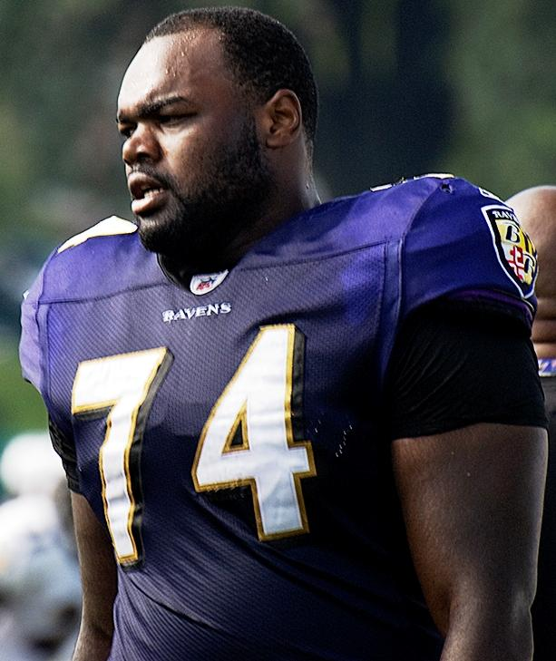
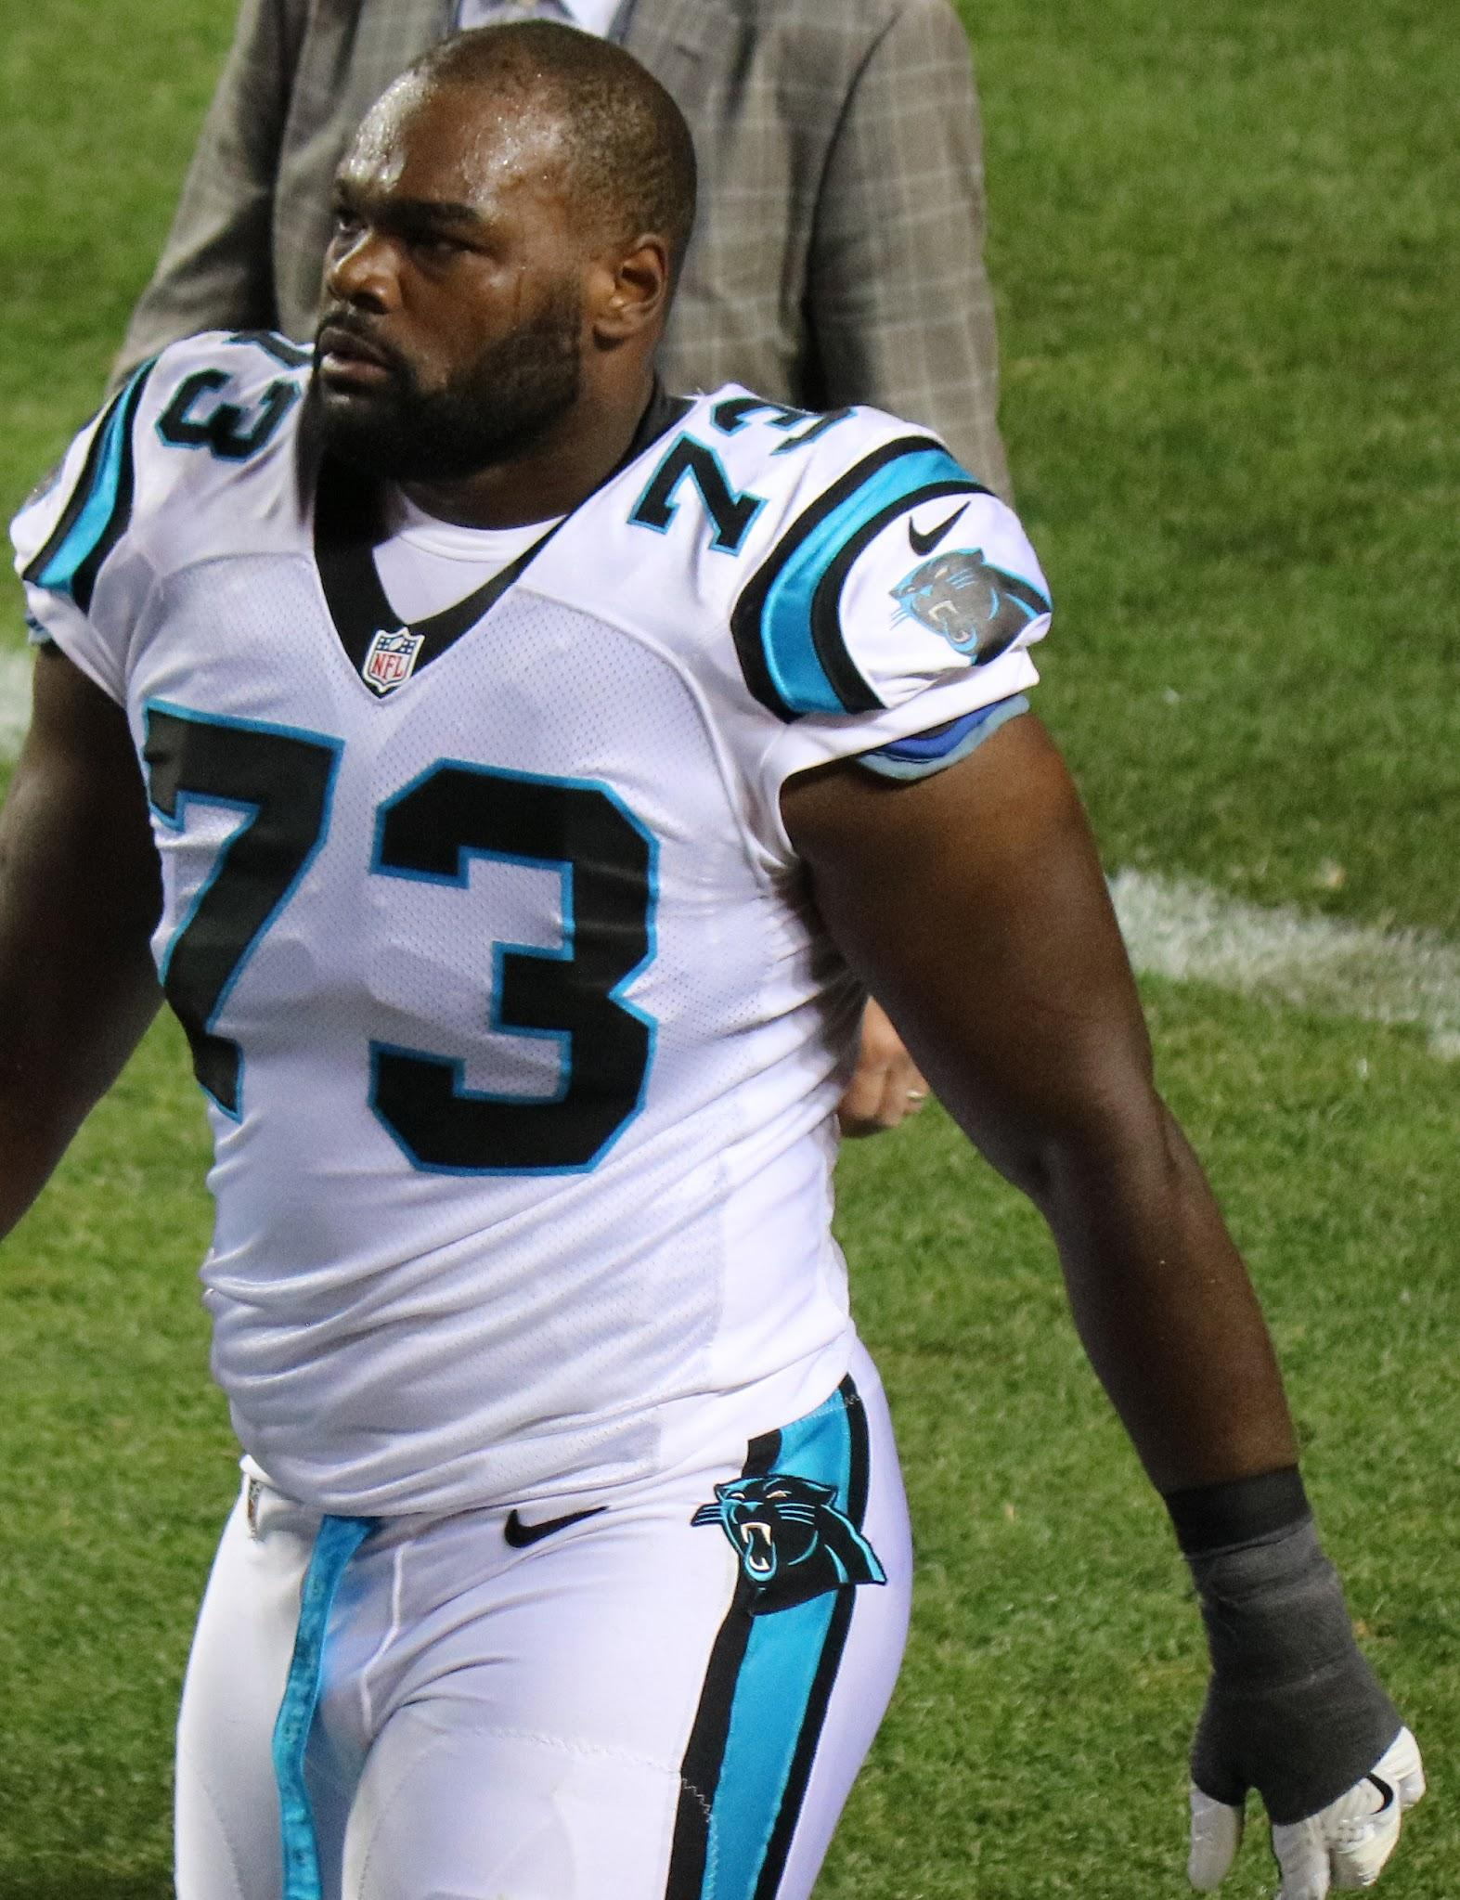
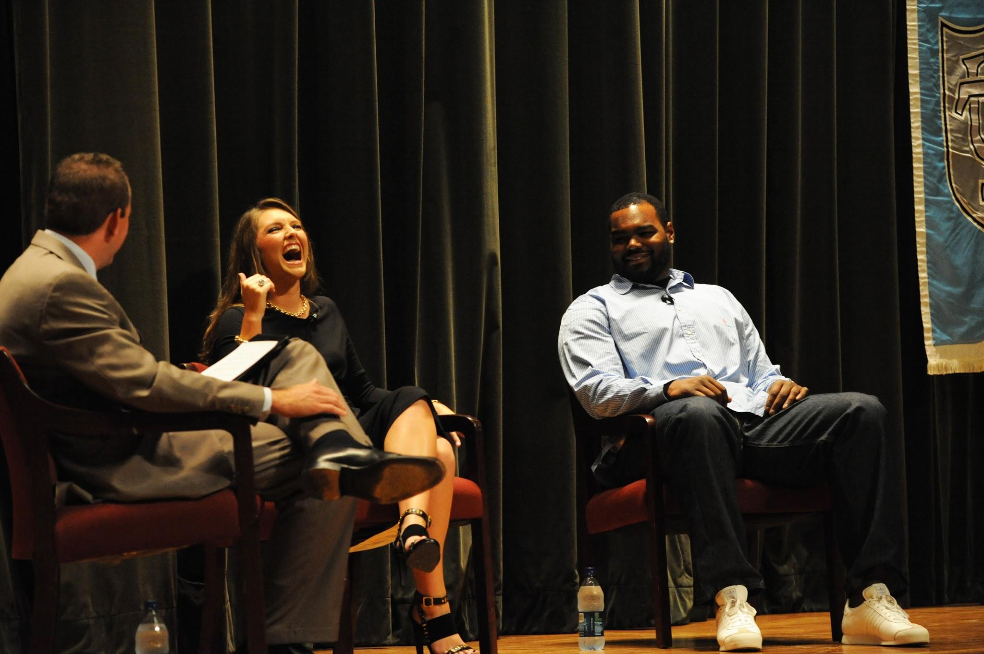
Main Characters
This book is an autobiography. Because of this, the main characters would be the author, and his friends/family that help him and are in the story the most. This story covers his whole lifetime up to that moment, so there are a lot of different people that help him. The people that I am going to list will be the people that are a part of the main climax. These include, Collins Tuohy (sister), Michael Oher, S.J. Touhy (Brother), Leigh Anne Tuohy (mother/guardian), and Sean Tuohy (father/guardian). Also, he has a tutor named Miss Sue, who helped him in school, so he could pass class. Everyone in the family, including Miss Sue went to Ole Miss. Collins is the same age as Michael. But S.J. is 7 years younger. Because of these people, Michael Oher was able to pursue his dreams.

Slide 4
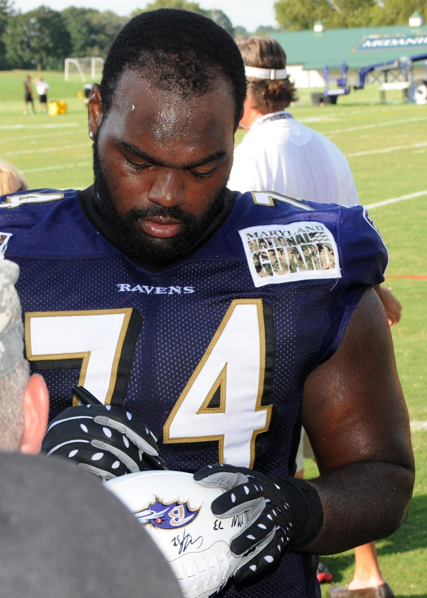
Michael Oher and How He Changes
Michael Oher , as it says in the book, went from homelessness, to the blind side, and beyond. When he was young, he and his siblings struggled with surviving. His mom struggled with addictions and locked her kids out of the house for days to weeks at a time. He went in and out of children services and foster care. One of his friend’s dad (Big Tony) took him to a Christian High school, called Briarcrest, his sophomore year. He struggled at the beginning of high school there because of the lack of education, but the teachers helped him find a way to learn. While at this school, the Tuohys took him in as part of their family and helped him become the person he is now. Michael Oher loves his family, and is very successful in football.

Slide 5
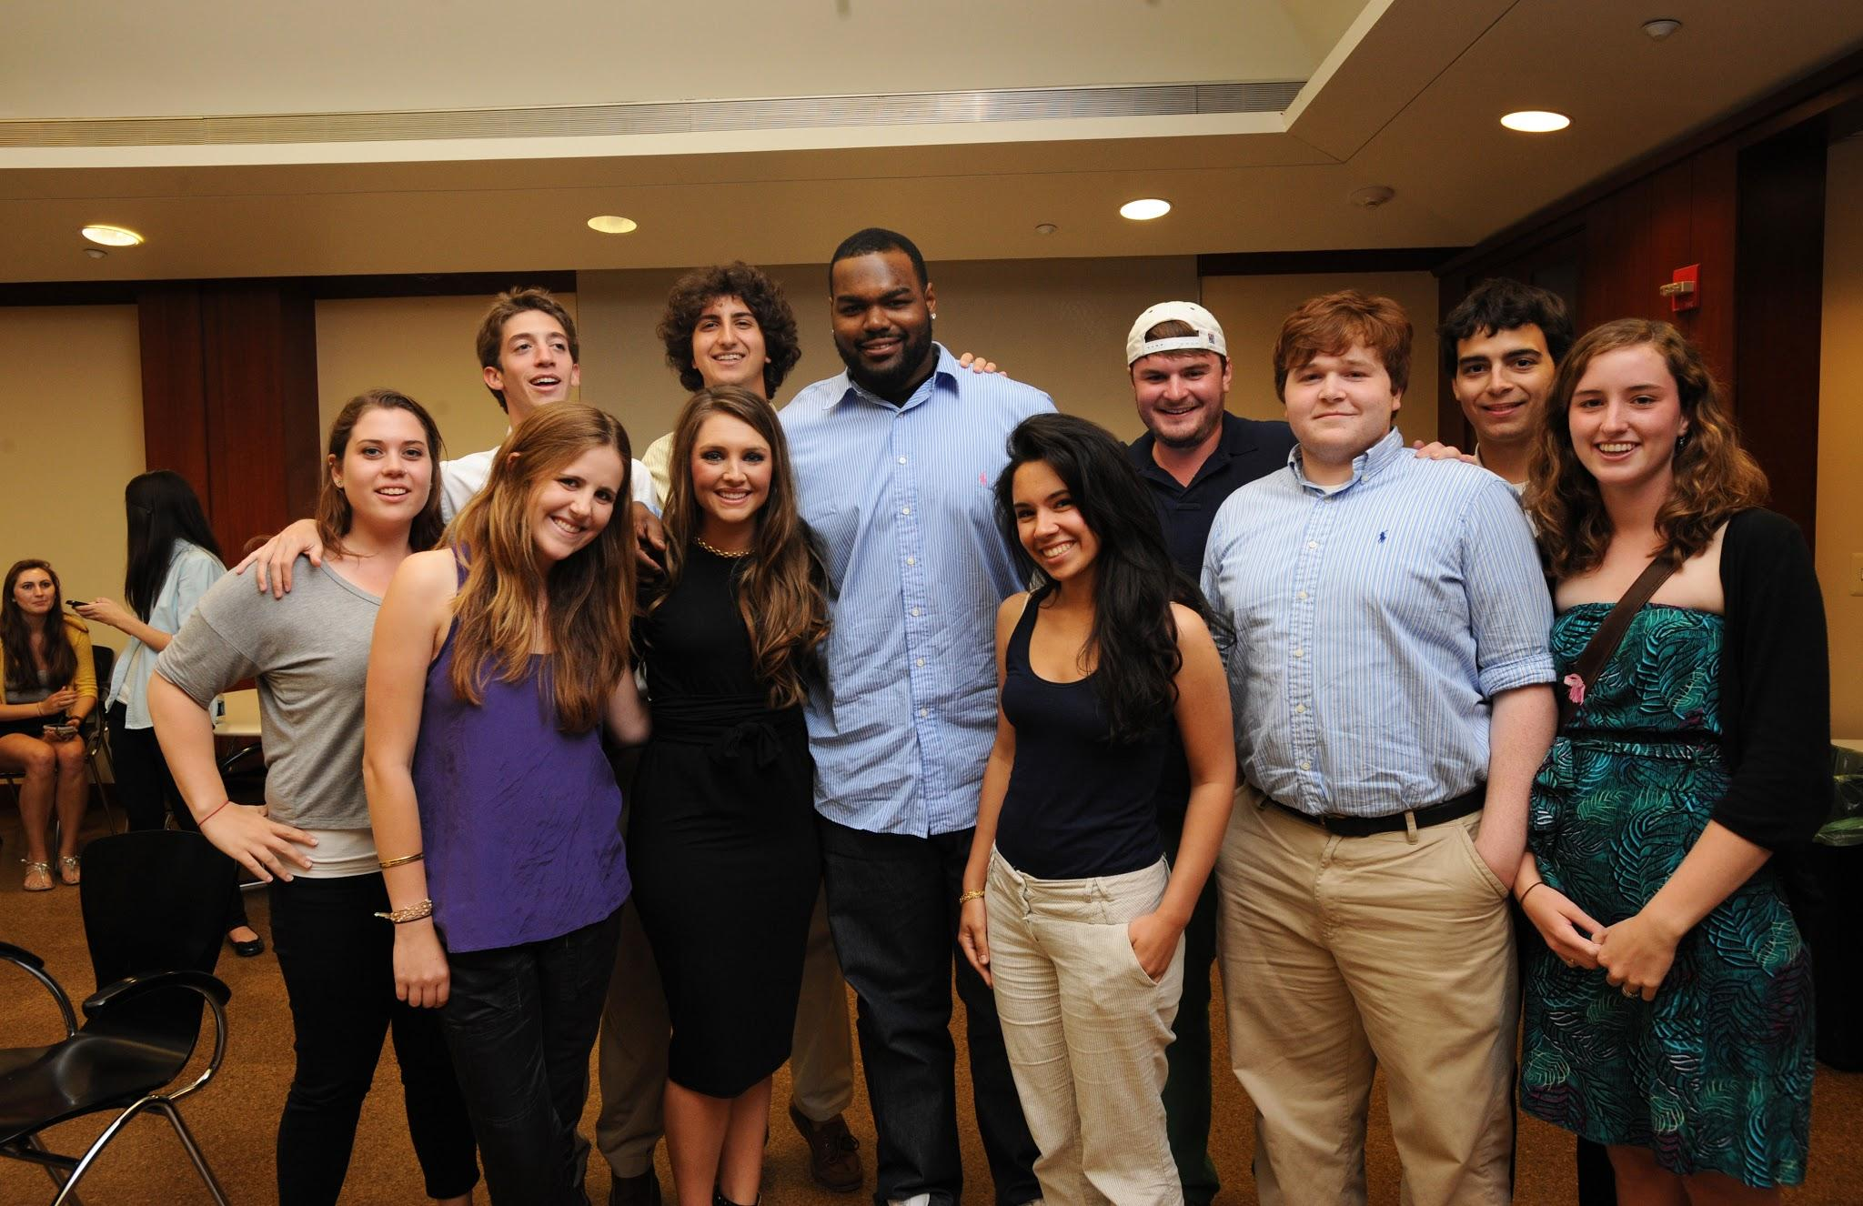
Climax
The climax is when the Tuohys took him in. The Tuohy parents became Michael’s legal guardians. They helped Michael follow his dreams of becoming a professional NFL player and make it into a college. The Tuohy family members are Collins (sister), Leigh Anne (mother/legal guardian), and Sean (father/legal guardian), Sean Jr/ S.J. (Brother). The Tuohys helped him get a good education at The University of Mississippi and play left offensive tackle (the blind side) for the Baltimore Ravens and the Carolina Panthers.

Slide 6
Extras
This book is 11 points with a 6.6 book level. It is an autobiography by Michael Oher.

