Slide 1
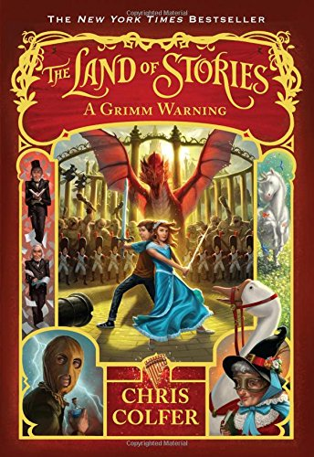
The Land of Stories
A grimm Warning
Slide by: Katie Jordan Points: 19.0 Level: 5.8 Author: Chris Colfer

Slide 2
Choosing the Main setting of the story
In this story There are two very important settings, including Germany and land of stories. Although both are very important Land of Stories, in my opinion, was more important. Without the Land of stories none of the main parts of the story would have happened. The French Army wouldn’t have come, Alex wouldn’t have became Fairy Godmother, and Conner wouldn’t have returned to the land of stories.

Slide 3
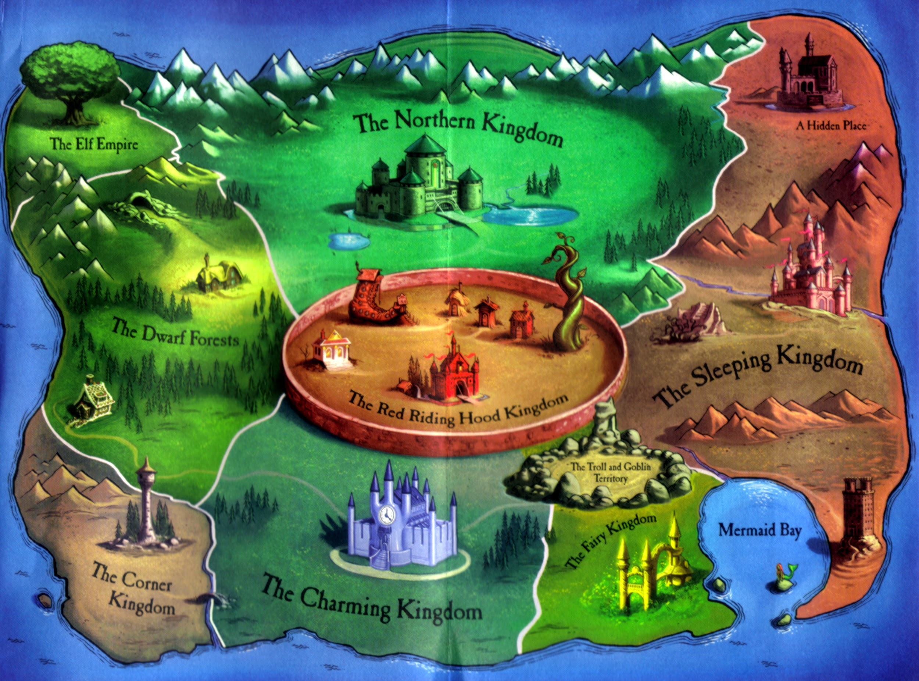
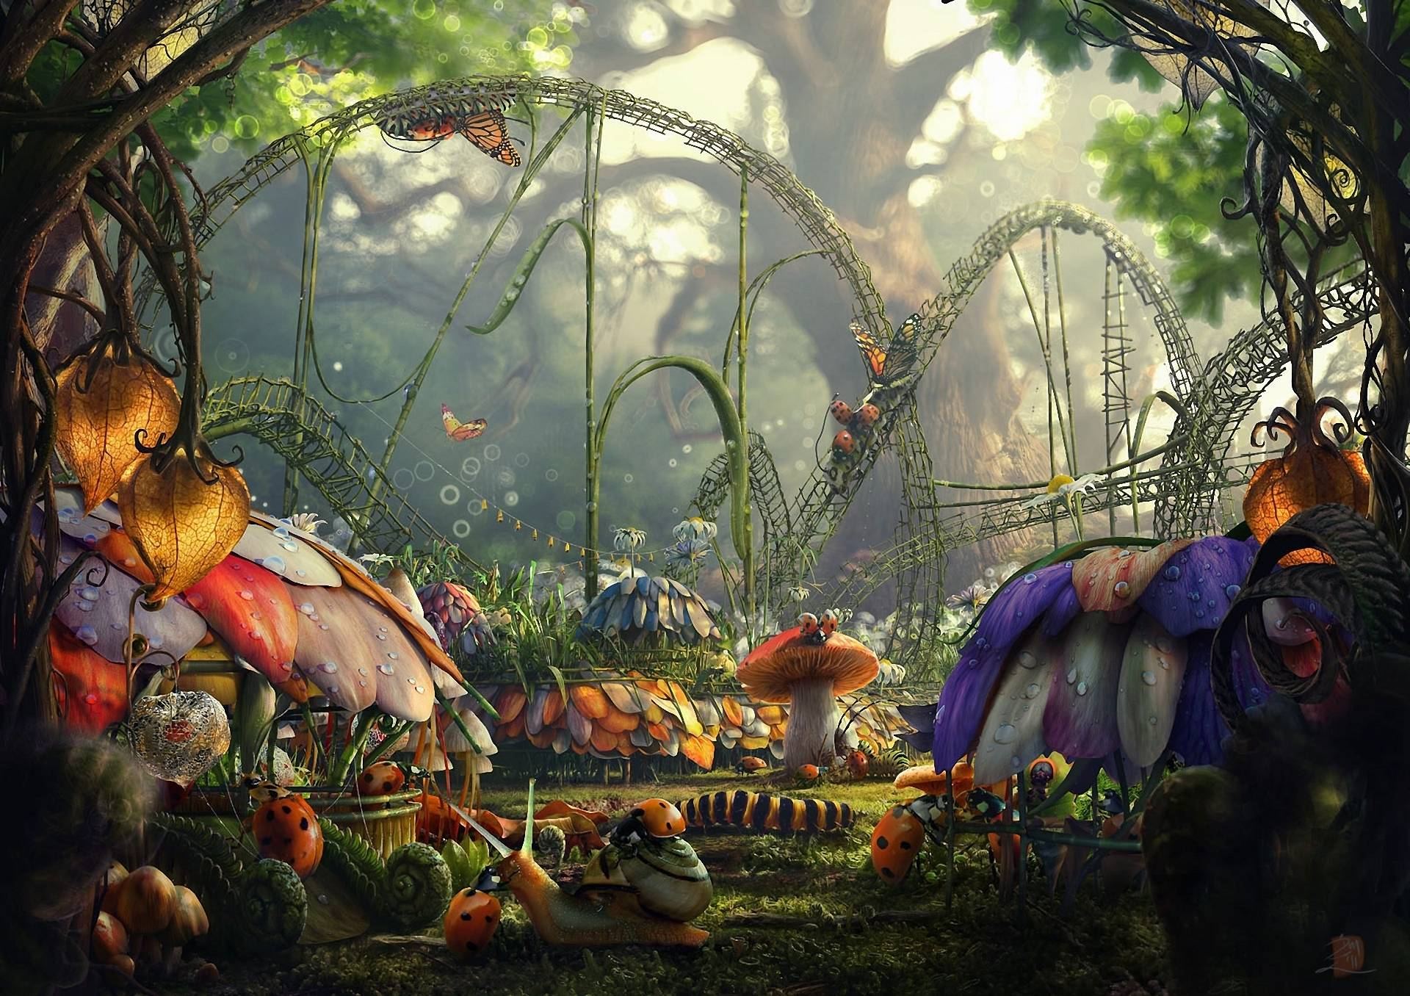
Main Setting of the Story
The main setting of the Land of Stories is all you can imagine fairy tale. If it is two herds of unicorns galloping majestically through a field or random witches showing up at your front door. Well if you don’t think that is a fairy tale then I don’t either. The Land of Stories is separated into kingdoms, just like how we are separated into countries. They are led by famous leaders like Sleeping Beauty, Cinderella, and Red Riding Hood. In Land of Stories there are very wealthy families and very poor families. It’s usually happy and whimsical but something bad is going to happen.

Slide 4
Summary of the Story
The Land of Stories was a very wild and interesting book. It started out with Conner going on a trip with Bree, Mrs. Peters, and some of his other classmates. On this trip, he and his classmates, went to a book reading from a story written by Brothers Grimm. They will later find out that this was a warning for later on. Because Connor's sister Alex has been living in the fairy tale world to train to be the next fairy godmother, Conner began to miss her and contacted her by running back to his hotel and using his magic mirror. When he did this, instead of Alex answering, Mother Goose answered. Mother Goose had told Conner to still go to the airport with them and sneak off to get a ticket to Berlin and exactly what to do when he got there. Now he was told all of this information in the airport bathroom so it took a while. Bree got suspicious and went in the bathroom to find him talking to Mother Goose on a magic mirror. So Conner told her everything and they sneaked off and got plane tickets with Conner’s debit card . When they got there, they rode bikes to a castle in a far away village nine hours away from Berlin. They headed straight to the Castle not knowing they had to get tickets. Luckily they met Emmerich who knew everything about the castle. He thought they were secret spies saving the world so he took them to the castle at three in the morning when no one was there. He led them through every room trying to find the right one, and finally found it.

Slide 5
Summary of the Story (cont.)
. Later they got to The Land Of Stories and stumbled into a forest later finding the enemy the Grande’ Armee’. They stayed as quiet as they could and ran to the castle. Next they met up with Alex to get ready for battle. They decided to go to different kingdoms and recruit armies, but something terrible happened at the worst time. Fairy godmother had fallen in a deep sleep. Then they heard the French had recruited prisoners to fight, but worst of all: THE MASKED MAN! They had to fight back, so they Fairytale world joined hands to defend their own kingdom one at a time to the point that the only place yet not to be battled -- the Fairy Kingdom. The French were coming, and “coming fast I tell you.” So Alex and Conner whipped up the biggest spell ever granted to bring all the armies to fairy Kingdom. Thankfully the French were outnumbered, and the world was saved; until, something horrible and terrible came-- a dragon, ed by who, well everyone’s favorite the Masked Man. Everyone panicked; then out of nowhere Fairy Godmother jumped out, and thankfully she outsmarted the Masked Man, and slayed the dragon. The world was now saved, Fairy Godmother died a peaceful death, Alex became the new Fairy Godmother, and everything was good again until maybe a day later when she found The Masked Man going through stuff stealing Fairy Godmother’s things. Alex fought back, by freezing him, took his mask off, and found, are you ready for this, it was her father!!!!

Slide 6
Characters//Alex//Protagonist
Alex is the new fairy godmother and is Connor's brother. When times are rough you can count on Alex to think up a smart plan to save the day. She is a leader if she knows it or not, and can always bring a smile to your face. If you need someone to stick up for you, Alex is your girl. when they were fighting off the enemy, Alex never hid in a corner. she fought just as much as the soldiers and maybe more. Although, Alex is a warrior, she also loves reading and writing. Before she lived in The Land Of Stories she went to the same school as her brother and was one of the smartest students.

Slide 7
Characters//Conner//Protagonist
Conner is Alex’s apprentice now since Fairy Godmother died. Usually Conner is just like any other kid, but when times get rough, he is always there for a helping hand. Conner is very clever, is very caring, and loves to write fairy tales just like Brothers Grimm. He has a giant crush on Bree, and always tries to impress her. After all the battling and exploring Germany together, Conner finds out she likes him to.

Slide 8
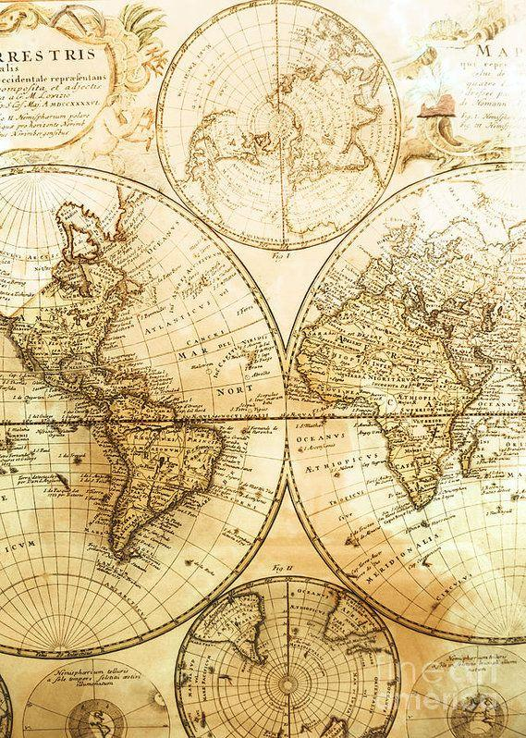
Characters//Mother Goose//Protagonist
Mother Goose is maybe one of the funniest book characters that was in a story. She always tries to fix things on her own and usually never can. She has a flying goose named lester, but he doesn’t talk. Everyone thinks Mother Goose is a wreck, but really she actually isn’t. When they were battling and the dragon came, Mother Goose knew she was going to die and wasn’t going to kill the dragon, but used it as a distraction. Luckily, Fairy Godmother saved the day. She carries alcohol with her at all times because it apparently helps her think.

Slide 9
Characters//Bree//Protagonist
Bree is a cool calm and collected girl with sly and smooth ways of getting things done. She loves horror and mystery books and is a sucker for a good crime scene. When it came to sneaking off into a 1,000 year castle with no one in it with them, she couldn’t have been happier. But, going to a whole other world really shook her up.

Slide 10
Characters//Fairy Godmother//Protagonist
Fairy Godmother is a smart, heroic, woman who never backs down from a challenge. If it wasn’t for fairy Godmother, Land Of Stories would be a mess. Even though every kingdom has a ruler, she is the head of all of them combined. If you need a potion ask fairy Godmother.

Slide 11
Characters//Grande’ Army//Antagonist
The Grande’ Army is everyone’s worst nightmare that never stops. They will kill everyone in sight, rampage innocent villages. When it comes to winning, they will never stop until they do. The Grande’ Army traveled in to the snowy mountains, and some soldiers died because of it. Do you think the Grande’ Army cared? No. all they cared about was getting the dragon and taking of the world.

