Slide 1
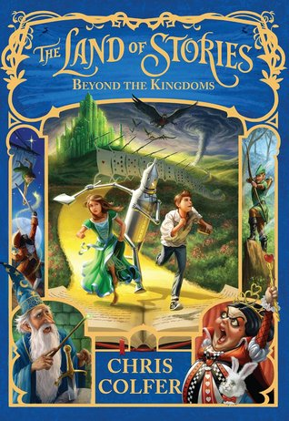
The Land Of Stories
Beyond The Kingdom
Book 4
By: Katie Jordan IR points: 14 points Level: 5.3
Book By: Chris Colfer

Slide 2
Setting of the story
In this story there are many settings, but the main is Land Of Stories. This is because most of the story takes place in land of stories, and most of the important scenes happen in this setting.

Slide 3
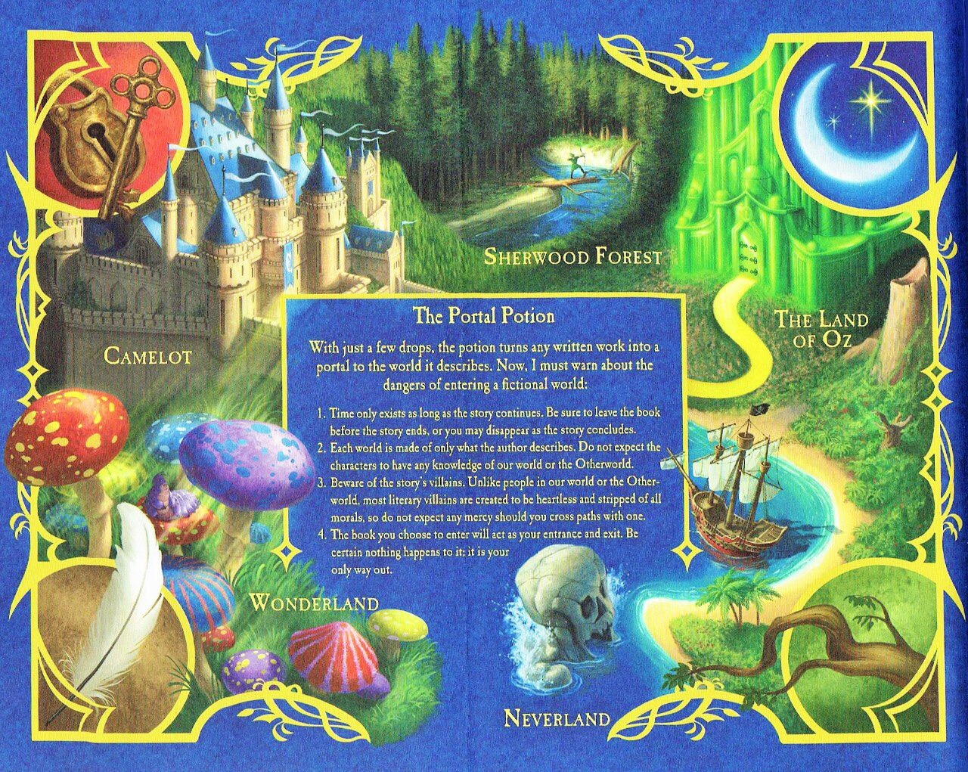
Other Important Scenes
In Book 3 there weren’t very many other settings that weren’t very important except for Otherworld and Land of stories. But, that is not the case in book 4. There are so many setting that made the book as good as it was including……
Land Of Oz
Neverland
Wonderland
King Arthur’s land in Camelot
The Merry Men of Sherwood forest
Otherworld
Second page is the story map

Slide 4
What the setting looks like

Slide 5
Things to know…...
The portal potion is the only way into the storybook land.
The Masked Man is Fairy Godmothers evil son.
Fairy GodMother invented the portal potion.
Masked Man took the potion so he could make an army of of evil villans to take over The Land Of Stories.
He recruited Captain Hook, Wicked Witch of the West and her flying monkeys, and The Queen Of hearts and her Card soldiers.
Alex and Connor are the Masked Man’s niece and nephew.

Slide 6
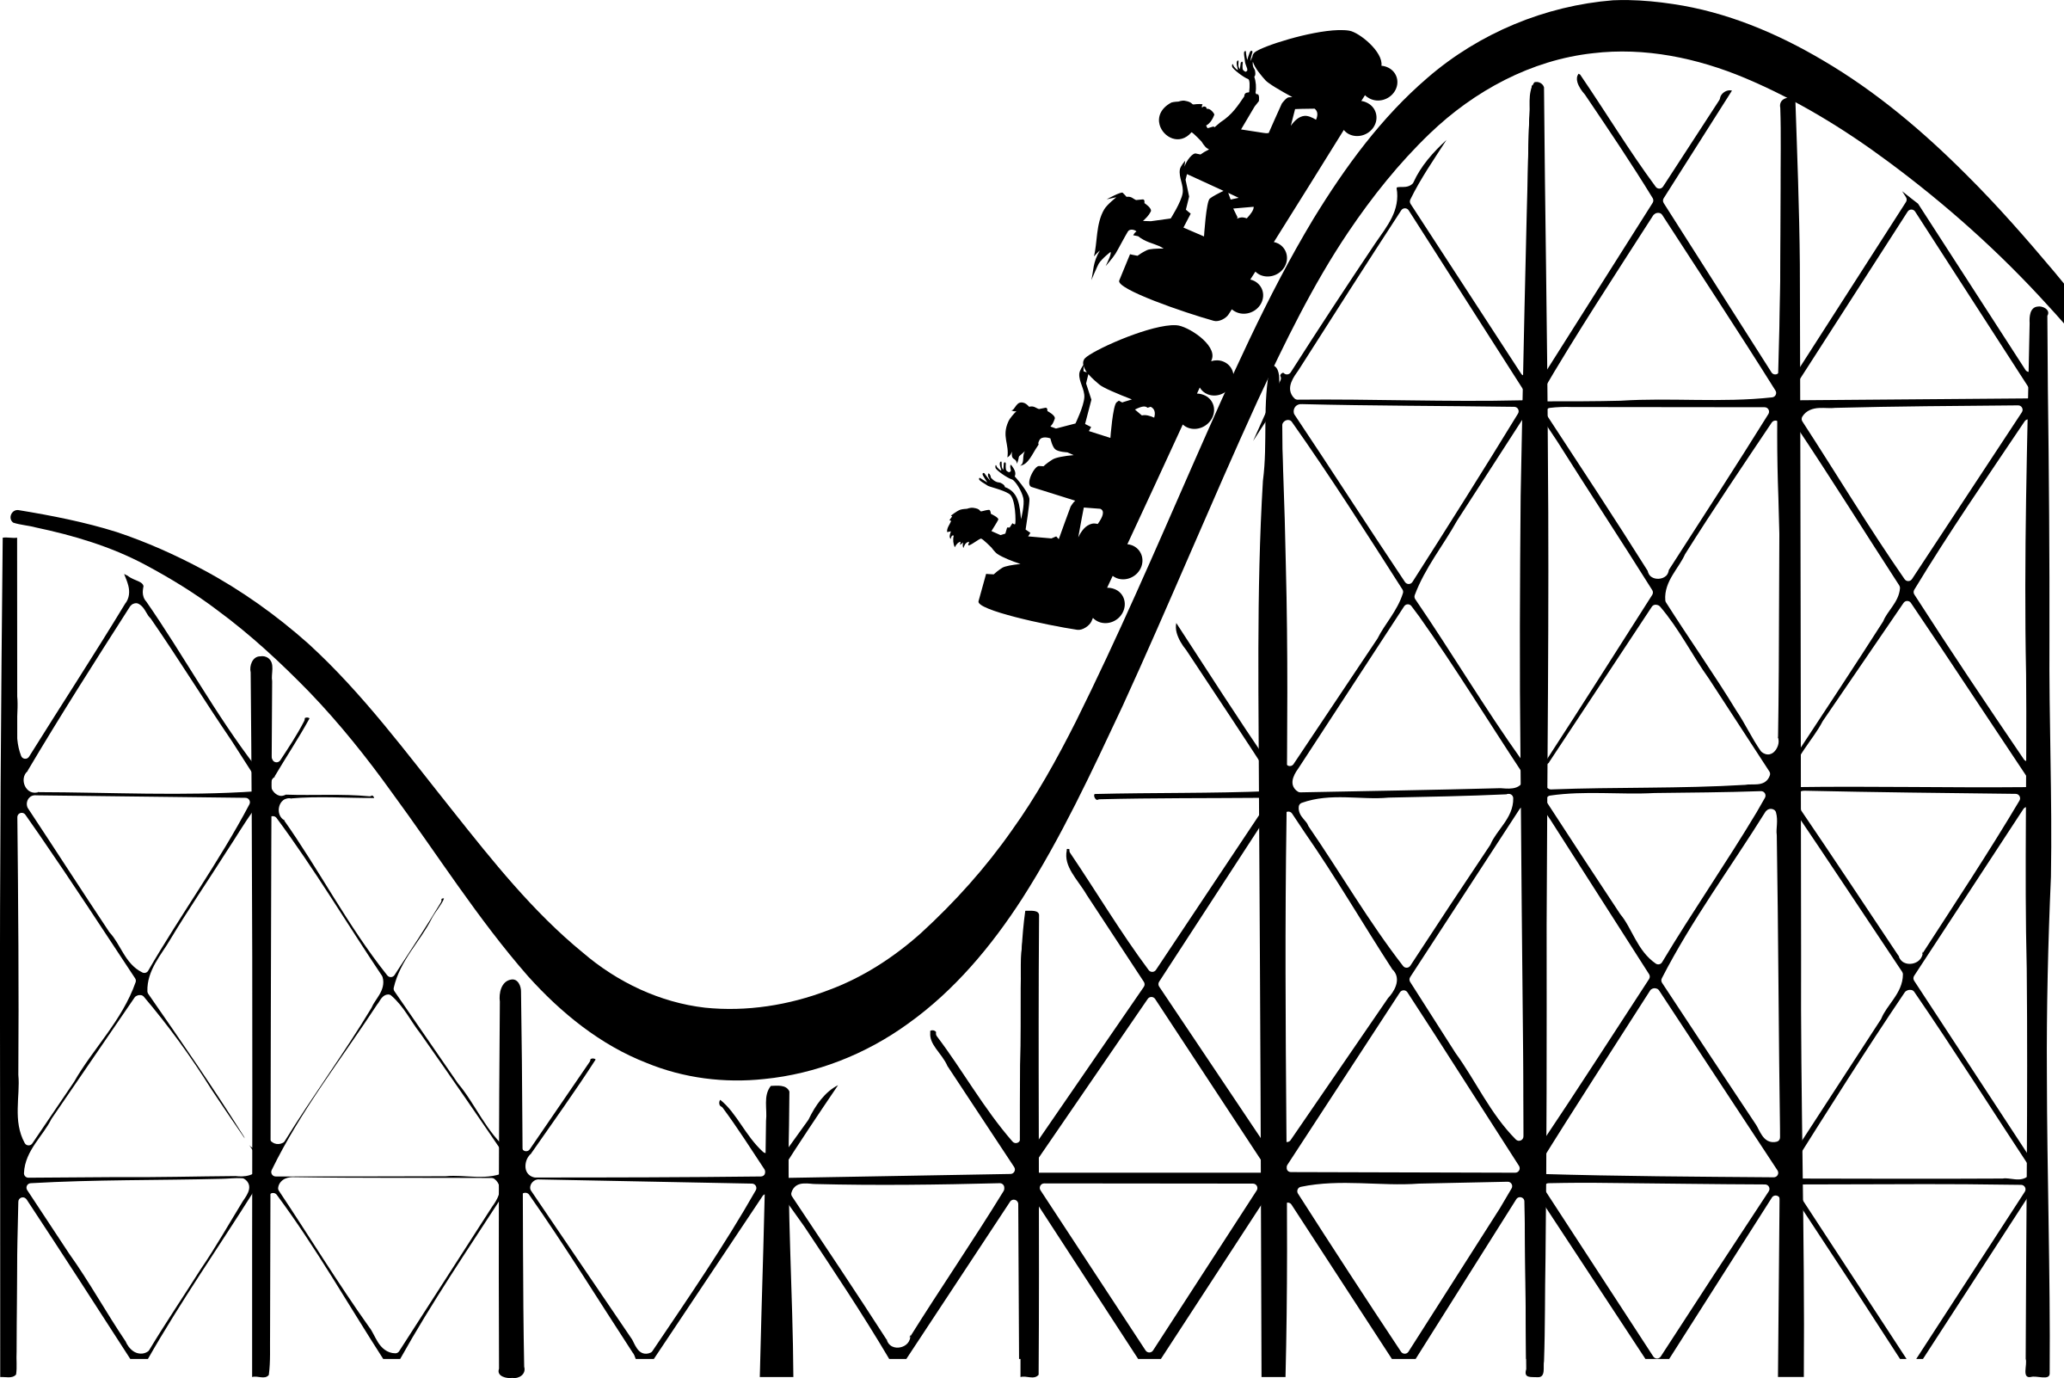
Plot Map Setting- Land Of Stories
Conflict- The Masked Man is trying to take over and
Destroy Land Of Stories.
Rising action- 1: Masked Man
goes into the first book OZ
2: Then Neverland to get Captain Hook
3: He later went to Wonderland to get Queen Of
Hearts and her Army of Cards.
4: Connor, Alex, Mother Goose ect. Follow Masked Man into the worlds and recruit good Characters.

Slide 7
Plot Map Part 2
Climax (Turning Point) : 5) Connor, Tin Man, and Peter Pan find the mask Man and get outnumbered by his army and thrown into a unown book. Then Alex, and Mother Goose get tricked into the wrong book.
Falling Action: 6) Connor and the other boys found themselves in sherwood forest
7) Alex and Mother Goose are in Camelot.
8) Alex and Mother Goose make a potion with merlin, and thankfully the boys were able to make a potion to and bring back Robin Hood and the Merry men with him.
Resolution 9) Both Groups Got out safely and were back in land Of Stories.

Slide 8
Characters// Alex
Alex is a strong, smart girl, who has no idea she is the most powerful fairy in the land. Ever since the last war, and the passing of her grandmother, she has lost control. Thankfully even through this, she is learning how to control it. She always wears a sparkly fairy dress made of the finest silk, and has brown hair.

Slide 9
Characters//Connor
Connor is Alex’s twin, He is Brave and is not afraid to take risks unless it includes math or magic, the two thing Alex Loves. When it come to making deals, he’s the kid you go to.

Slide 10
Characters// Mother Goose
Mother Goose is an outgoing old Lady with a pet goose named Lester. If you want a laugh, go to her, or if you ever have a angry lake lady about to drown all your friends, go to her. Sadly she didn’t go back to Land of stories because she fell in love with Merlin.

Slide 11
Characters// Tin Man
If you were to meet Tin Man, you
would think he had a heart
because of how caring and
compassionate he is. If you need
someone to rely on, he is the guy.

Slide 12
Characters//Peter Pan
Peter Pan is how you would expect a kid who never grows up and can fly would be. Absolutely crazy and immature, but when he is needed, he can really come through and do what he needs to do.

Slide 13
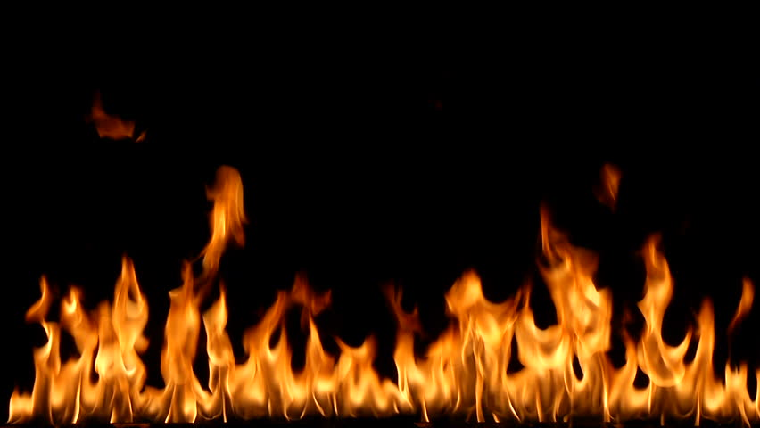
Characters// Masked Man
The masked man is all you can imagine in a bad guy. When he was a kid, all he would do was read books about how to destroy the world, so Fairy Godmother (His Mom) drained his powers. He always wore something over his head, so no one ever knew who he was.

Slide 14
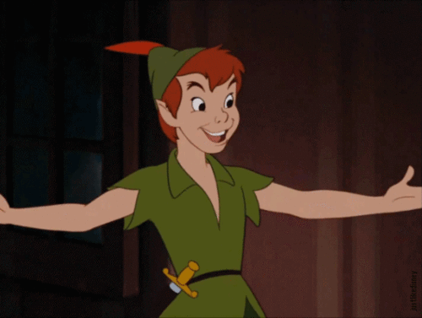
Thanks For watching Hope you enjoyed!!!!!

