Slide 1
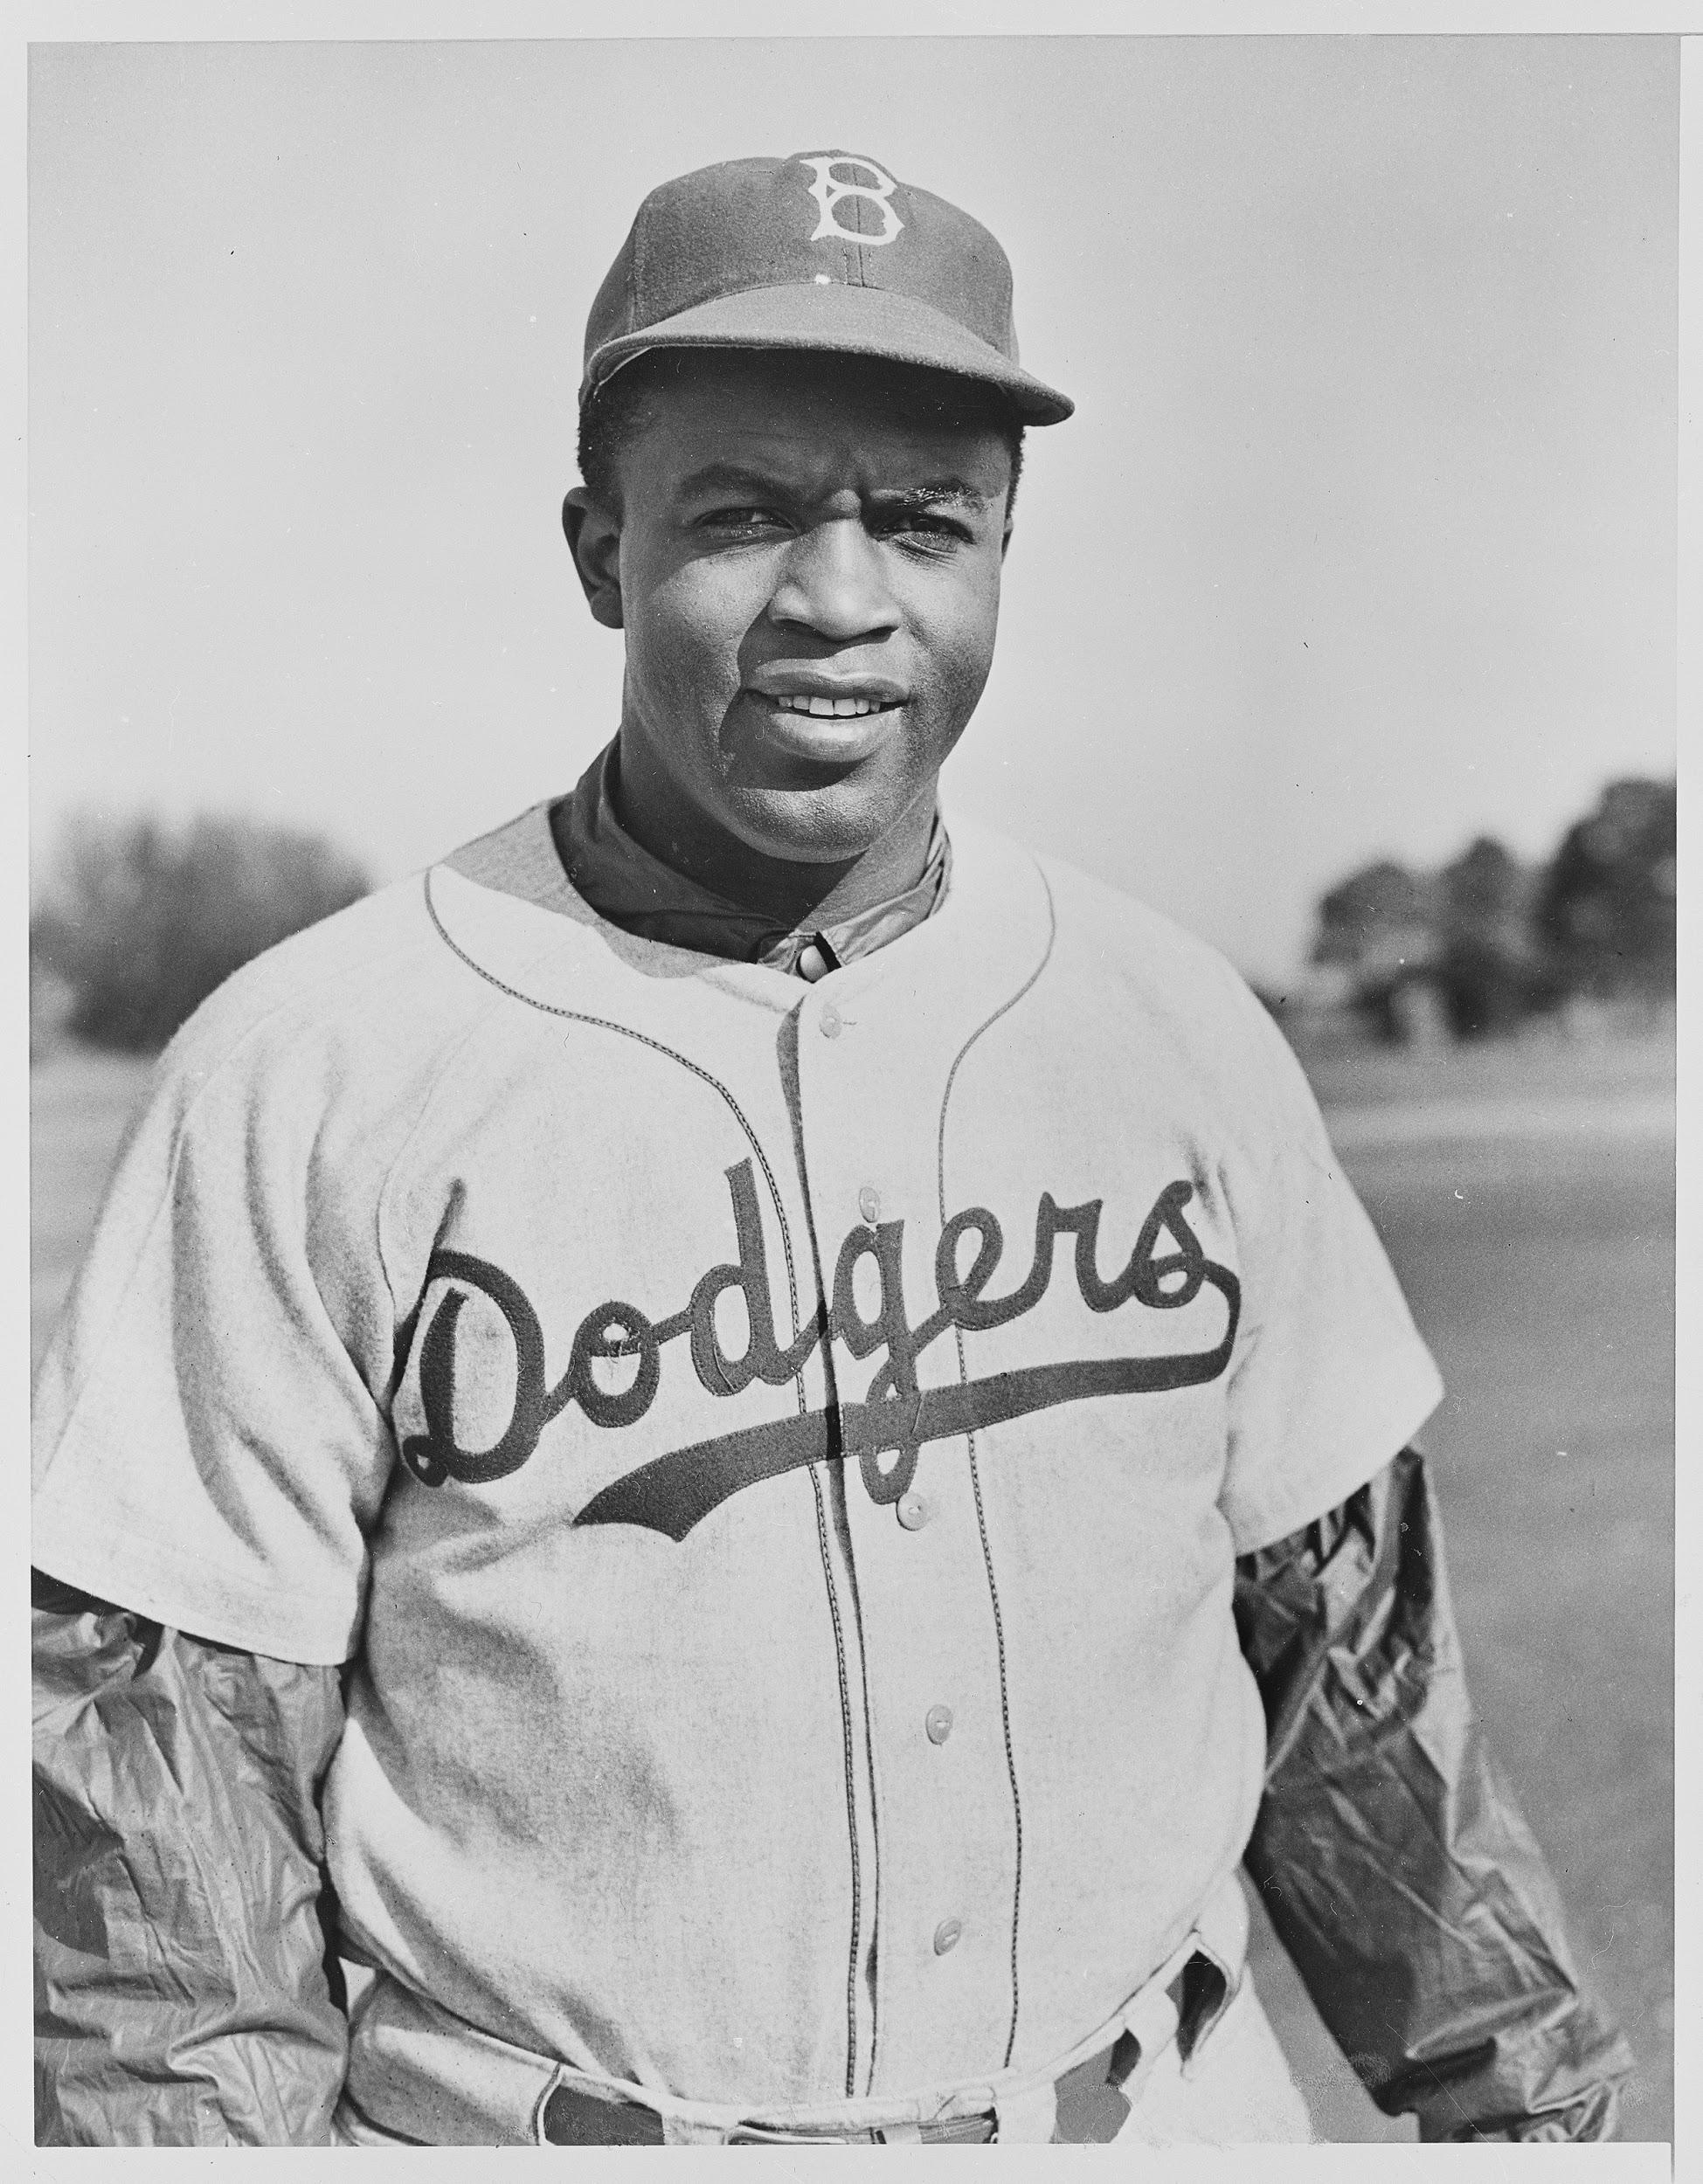
The Hero Two Doors Down
By: Sharon Robinson
Report by: Brooklynn Short

Slide 2
Main Characters
Stephen Satlow is the main character. He is sly and is always getting in trouble in school. He and his dad love the Dodgers.
Jackie Robinson is the secondary main character. Jackie is courageous and strong while being discriminated against.
Other Characters
Mrs.Robinson (Rachel) -Jackie's wife, Jackie Junior- Jackie’s son, Sarah- Steve’s mom, Steve’s dad who goes by Dad throughout the story

Slide 3
Setting
The main setting is Tiden Avenue in Brooklyn, New York. The neighborhood is an all Jewish neighborhood. When the Robinsons move in some people are against it because the Robinsons are Christian.

Slide 4
Protagonist
The protagonist in this story would be Stephen. In the beginning Stephen gets in trouble a lot. After he finds out that a Dodgers’ player is moving in two doors down, he works hard in school so that he can go to the Dodgers’ opener.

Slide 5
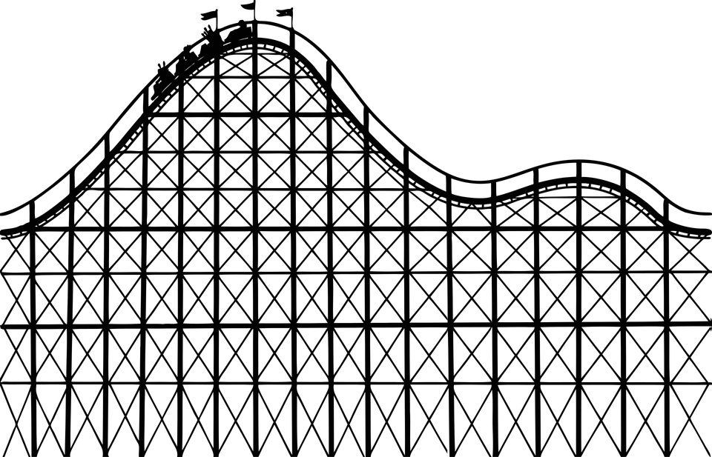
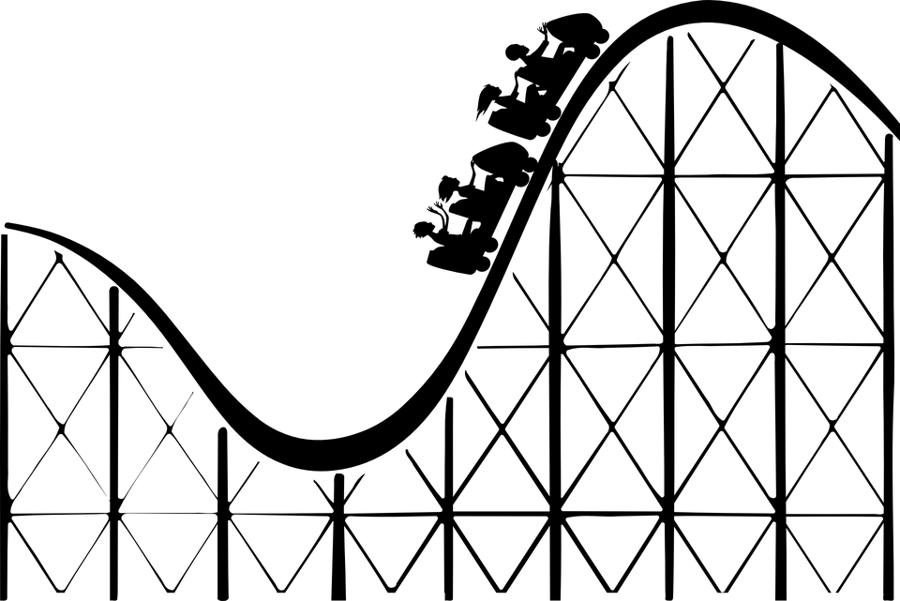
Plot Map
Conflict: Stephen gets in trouble in school a lot.
Stephen finds out a Dodgers’ player is moving in two doors down.
Stephens dad finds out that the player is Jackie Robinson.
Stephen sits outside hoping to see Jackie.
Stephen is good in school so he gets to go to the Dodgers’ opener.

Slide 6
Plot Map
Conflict: Stephen gets in trouble in school a lot.
Stephens parents and Mrs. Robinson surprises him by arranging him to meet two Dodgers players.
Stephen and Jackie become friends.
For Stephen's birthday Jackie gets Dodger tickets for his class.
Stephen helps decorate the Robinsons Christmas tree.

Slide 7
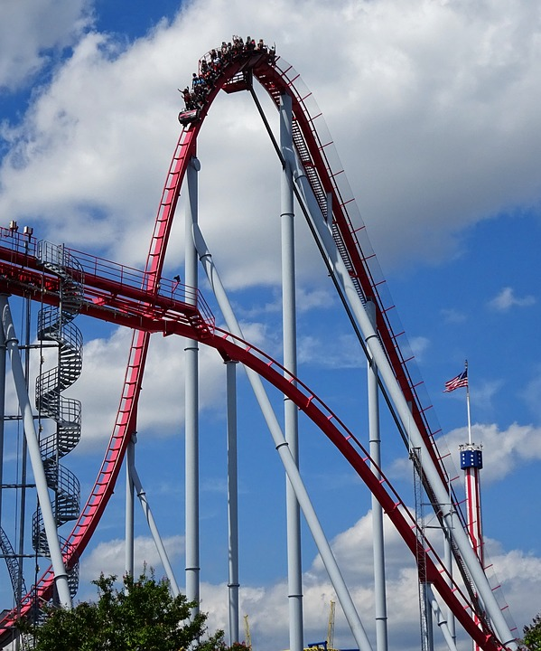
Plot Map
Jackie gets Stephen a Christmas tree not knowing that the
Satlows don’t celebrate Christmas because they are Jewish.
Stephens dad invites the Robinson over for the big family
Dinner with them
Jackie and Stephen light the menorah together
Jackie moves away and Stephen is heart broken
Stephens dad passes
Resolution: Jackie Robinson and Stephen stay friends!

Slide 8
Favorite Parts
My personal favorite part is when Jackie and Stephen first meet (the Dodgers’ opener). I like this part because he finally meets his hero.

