Slide 1
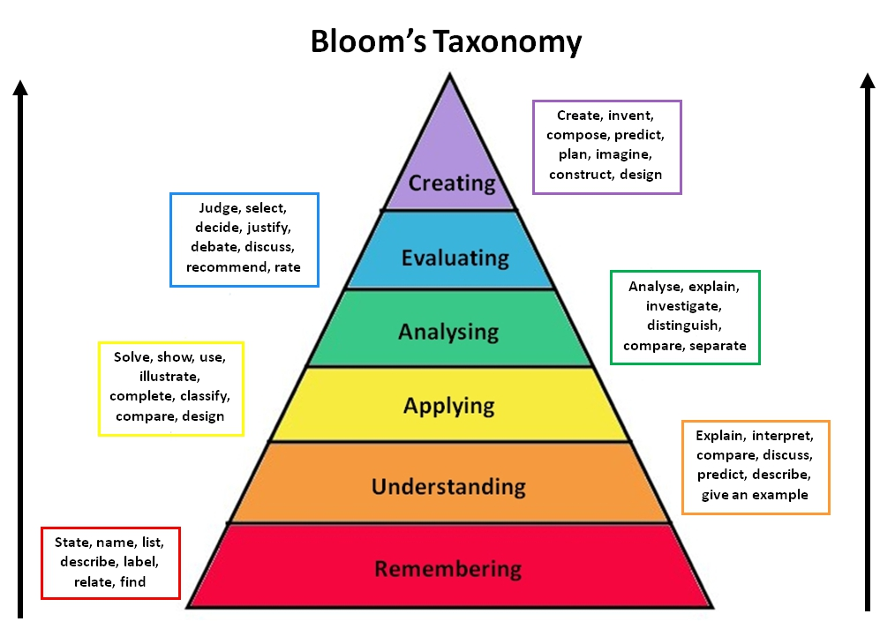
6
5
4
3
2
1

Slide 2
The child pushed the red wagon.
6 Create:
Do research by observing several children playing with wagons. Publish your research.
Write and illustrate a story about a child and the wagon.
5 Evaluate:
Are wagons a good toy for children?
Support your judgment.
Analyze
Compare the value of wagon to other toys.
Explain your answer.
Apply
Why is the child pushing the wagon?
Understanding
How old is this child?
Remembering
What color is the wagon?

